Slide 1

Social Distancing Detector
Submitted in the partial fulfillment for the award of the degree of
BACHELOR OF ENGINEERING
in
Artificial Intelligence and Machine Learning
Submitted by:
Tushar Chauhan (18BCS6162)
Saksham Bahuguna (18BCS6164)
Deepanshu Manchanda (18BCS6212)
Lokesh Deshwal (18BCS6219)
Under the Supervision of:
Prof. Shifali Sharma
Department of AIT-CSE
DISCOVER . LEARN . EMPOWER

Slide 2
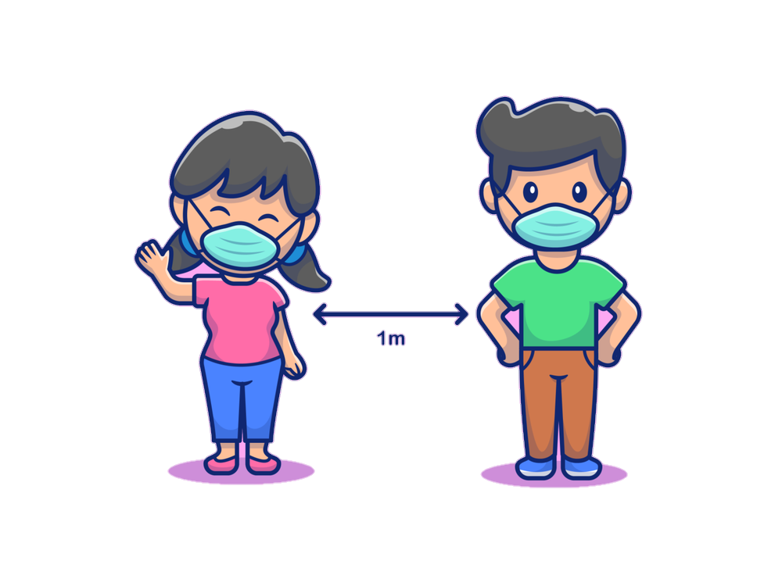

Outline
Introduction to Project
Problem Formulation
Objectives of the work
Methodology used
Results and Outputs
Conclusion
Future Scope
References

Slide 3

Introduction to Project
COVID-19 has made people learn a new word Social Distance and thereby encouraged people to maintain Social Distancing.
Social Distance is a self-explanatory word that means to distance ourselves from everyone around us.
Social Distancing Detector basically detects whether social distancing is properly followed in the input provided.
The output of the model is the objects traced by red and green rectangles. Red illustrates Social Distance Violation and Green represents that the Social Distancing norms are followed.

Slide 4

Introduction to Project
This project Social Distancing Detector aims at detecting whether social distancing is being followed under a given input in the form of a video. This project uses OpenCV, Deep learning and computer vision in implementing the Social Distancing. The input is the video or mp4 file of any street or shop where we have moving objects (humans here).
After the computational work done at the backend in the code, the output is the objects traced by red and green rectangles. Red illustrates Social Distance Violation and Green represents that the Social Distancing norms are followed. The output also consists of the number of Social Distancing Violations that could help a lot.

Slide 5

Problem Formulation
COVID-19 is the toughest time the world is suffering through. Social Distancing is a new problem these days.
On one side there are people who take all these terms like Social Distancing, wearing mask seriously but a coin has two sides and on the other side people are violating Social Distancing and here is the scenario where this model solves the problem.
Social Distancing Detector is a model which is capable of segregating humans and then identifying whether social distancing is followed or not. The model detects humans and then calculate the distance between them by considering the moving people as objects and allocating rectangles to them.

Slide 6
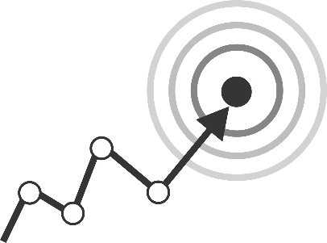
Objectives
Social Distancing Detector aims at providing accurate results of the given input stream by effectively calculating the distance between the persons and separating them as violation of the norms or social distance is maintained.
Model helps in maintaining social distancing and detecting whether social distancing is followed or not.

Slide 7

Methodology used
The following methodology will be followed to achieve the objectives defined for proposed research work:
The model/project used OpenCV, deep learning and computer vision for the detection of social distancing.
Object detection is applied to detect only people from the input video. Then the distances are calculated pairwise among the people and finally the distance between two persons, if it is less than ‘n’ pixels then a violation is counted else Social Distancing is followed.
YOLO object detector is used to detect people.

Slide 8
The input of the video stream can be provided by giving the path else the webcam will be used as an input. The output of the video is must else the video will not be exported to the disk.
Euclidian distance is calculated between the centroids of the boxes. If the distance calculated is violated then it is added to the violate variable or list.
The box coordinates are extracted and the boxes are initialised as green colour. The bounding of the persons is drawn and their centroid. The number of violations is displayed on the output screen.

Slide 9
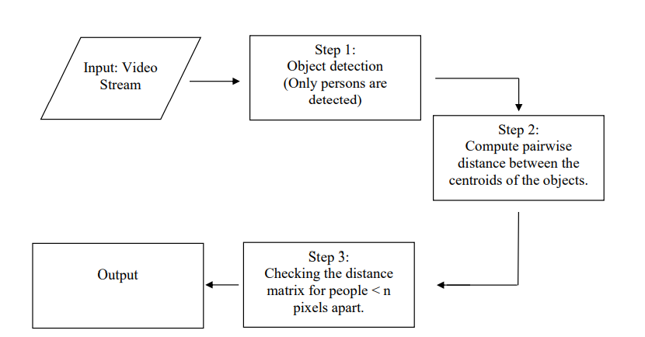
Flowchart

Slide 10

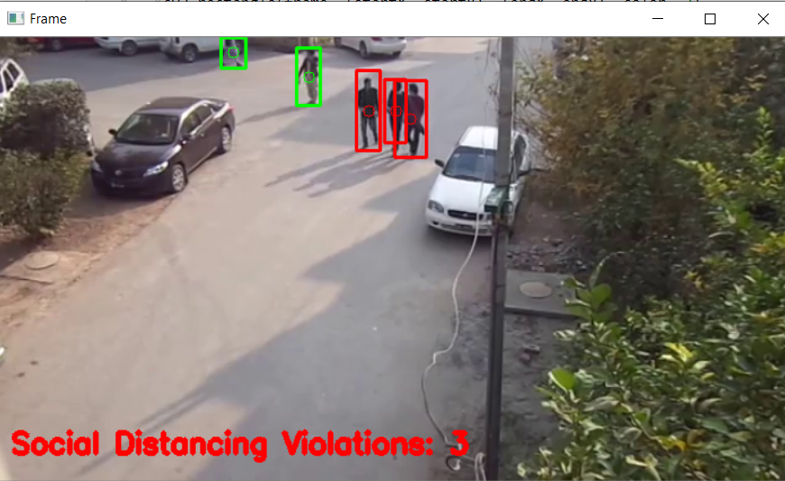
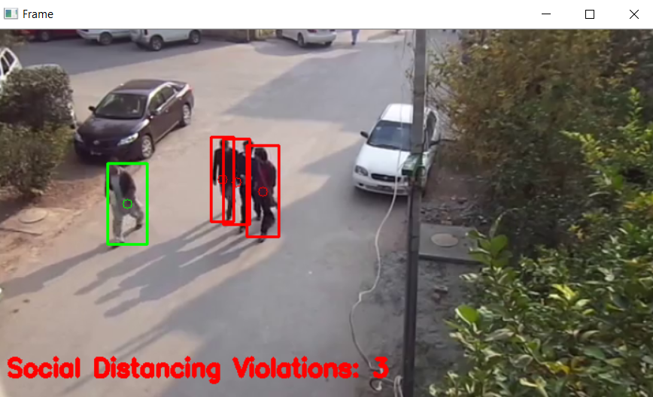
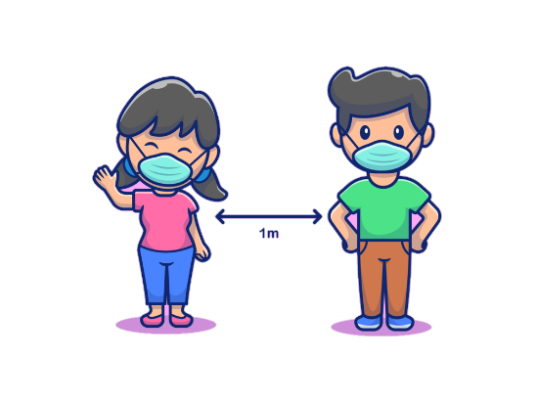
Results and Outputs
Please follow Social Distancing.

Slide 11
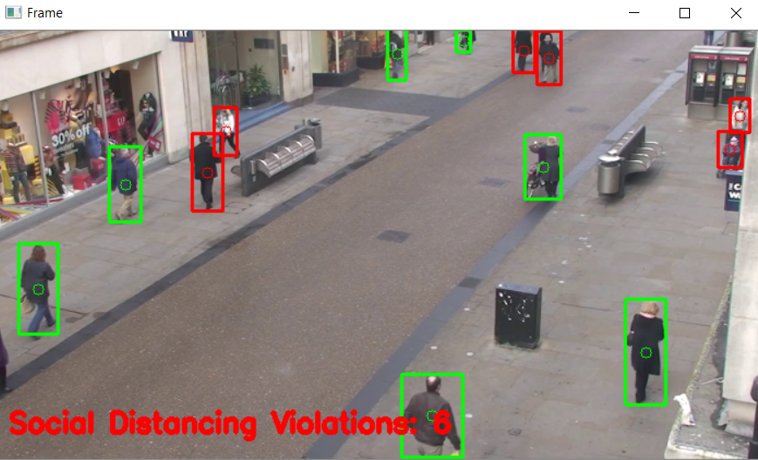
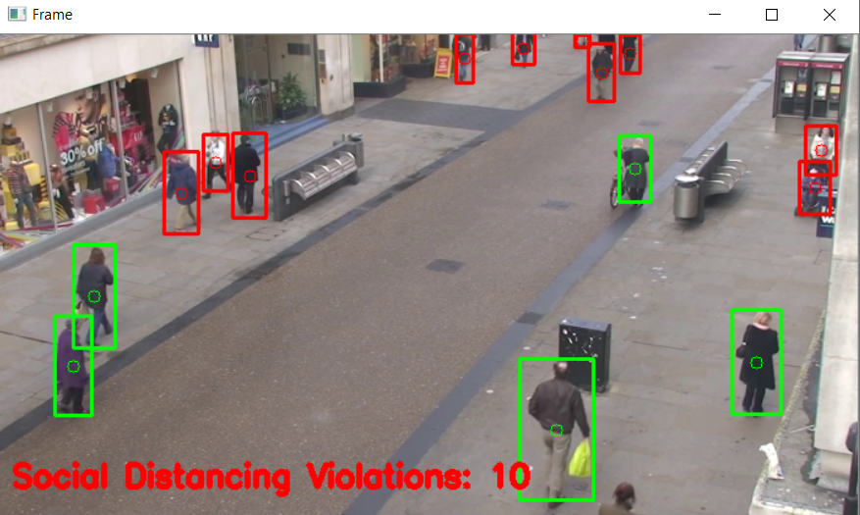

Slide 12

Conclusion
Social Distance is a self-explanatory word that means to distance ourselves from everyone around us.
Our work distinguishes the social distancing pattern and classifies them as a violation of social distancing or maintaining the social distancing norm. Additionally, it also displays labels as per the object detection.
It thereby helps in reducing the spread of contaminated and contagious diseases like the novel COVID-19 these days.

Slide 13
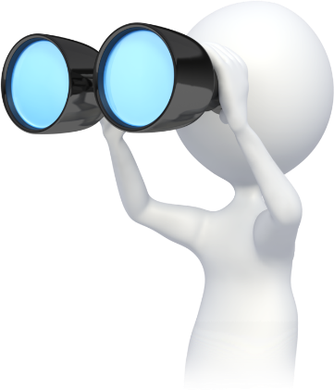
Future Scope
The classifier was then implemented for live video streams and images also. This system can be used in CCTV for surveillance of people during pandemics.
Mass screening is possible and hence can be used in crowded places like railway stations, bus stops, markets, streets, mall entrances, schools, colleges, etc.
By monitoring the distance between two individuals, we can make sure that an individual is maintaining social distancing in the right way which will enable us to curb the virus.

Slide 14

References
[1]S Yadav Deep learning based safe social distancing and face mask detection in public areas for covid-19 safety guidelines adherence
[2]W Liu, D Anguelov, D Erhan, C Szegedy, S Reed, C Y Fu, A C Berg European conference on computer vision, p. 21 - 37 Posted: 2016
[3]N Singh Punn, S K Sonbhadra, S Agarwal Monitoring covid-19 social distancing with person detection and tracking via fine-tuned yolo v3 and deepsort technique

